Slide 1
Exploring Banner Finance Pages
Banner 9
Banner Finance
University Controller’s Office

Slide 2
What are Banner Pages?
Financial information for Banner funds, orgs and transactions are returned on Banner pages. Each page allows the user to view specific information and perform specific tasks. In this training module we will explore some of the most commonly used Banner pages, discuss their purpose and how to interpret the information retrieved.
Let’s begin with some information you’ll need to know in order to navigate and understand the information presented on Banner 9 Finance pages.

Slide 3
What’s in a Name?
Banner uses a 7 character name for all pages, tables and processes. This naming convention helps organize hundreds of pages and processes in logical order determined by character position. At first, the names can seem odd or hard to remember, but once you understand the naming conventions, the Banner page acronyms will become second nature.
Each position (character) of the Banner page page represents a system, module or identifies the purpose of the page. Let’s look at an example.
Banner Finance page FGIDOCR = Finance, General Ledger, Inquiry,
Document Retrieval pae.
Position 1, F for Finance, identifies the primary Banner system. Other system identifiers include:
G=General R=Financial Aid
N=Position Control S=Student
P=HR/Payroll Personnel T=Accounts Receivable

Slide 4
What’s in a Name?
Banner page FGIDOCR:
Position 2, G for General Ledger, identifies the module within the system. Other Finance modules include:
A=Accounts Payable O=Operations
B=Budget Development P=Purchasing
C=Cost Accounting R=Research Accounting
Position 3, I for Inquiry, identifies the type of page, report, job or table. Other types of pages include:
A=Application Q=Query
B=Base Table R=Rule Table
M=Maintenance V=Validation
Positions 4-7, DOCR for Document Retrieval, are an abbreviation of the page’s description name. Other examples of page names include:
IDEN=Identification ENCB=Encumbrance DOCH=Document History
BDSR=Budget Summary GITD=Grant Inception to date BDST=Budget Status
DOCR=Document Retrieval CHKH=Check History GLAC=General Ledger Activity

Slide 5
Document Types
Document types are used to identify the various transactions found in Banner Finance. Using document types help the user perform queries and interpret the information returned on document history pages. The most common types of documents found in Banner Finance:
  CHK=Check Disbursement
  CM=Credit Memo
  ENC=Encumbrance
  INV=Invoice
  JV=Journal Document (used for journal entries, budget entries and cash receipts)
  PO=Purchase Order

Slide 6
Rule Classes
Rule classes further define document types. They are used to ensure that Banner transactions post to the appropriate Banner ledger or module. Most Banner pages automatically invoke specific rule classes and therefore the user is never prompted to provide them. Rule class codes can also be used for query purposes on certain banner pages such as FGITRND(Detail Transaction Activity) and FGIGLAC(General Ledger Activity).
Knowledge of rule class codes is vital for entering Banner journal entries, budget entries and cash receipts. These rule classes are known as Types and must be entered by the user.
On the following page is a list of rule classes (rule types). Those listed in green are entered by departmental staff who have Banner security access to enter transactions. The others listed are entered by various noted administrative departments.

Slide 7
Rule Classes
CODE |  | Who enters | CODE |  | Who enters
BPE | Permanent Budget Adjustment Expense | Departments | BD01 | Permanent Adopted Budget | Budget office only
BPR | Permanent Budget Adjustment Revenue | Departments | BD02 | Permanent Budget Adjustments | Budget office only
BTE | Temporary Budget Expense Transfer | Departments | BD03 | Temporary Adopted Budget | Budget office only
BTR | Temporary Budget Revenue Transfer | Departments | BD04 | Temporary Budget Adjustment | Budget office only
CCC | Departmental Combined Card Deposit | Departments | MCH | Manual cash deposit | Cash operations only
CCH | Departmental Cash Only Deposit | Departments | MCK | Manual check | Cash operations only
CCK | Departmental Check Only Deposit | Departments | MCC | Manual combined credit card | Cash operations only
CDS | Departmental Deposit Discover Card | Departments | ACH | Outgoing ACH | Cash operations only
CMC | Departmental MC Visa Deposit | Departments | WIR | Outgoing Wire Transfer | Cash operations only
CMX | Departmental Deposit Amex Card | Departments | JE16 | General Journal Entry (Inter-Fund) | Interfaces & Controller's office
X01 | JV for Revenue Transfer | Departments | X16 | Journal entry for SIS | Student accounting only
XEX | JV for Expense Transfer | Departments
XIC | JV for Internal Charge | Departments
XLF | JV for Local Non Mandatory Transfer | Departments

Slide 8
Banner Index Codes
Many Banner pages use the Banner Index field to retrieve and post information. Index codes were developed to save time and ensure that data is accurately entered into Banner. An Index code defaults to a unique combination of Fund, Org (organization), and Program codes that represent part of the FOAPAL in Banner. Think of it as a routing number.
The Banner FOAPAL is covered in greater depth in the FOAPAL training module.

Slide 9

Navigating Banner Pages
This is the Banner General Menu page. You can type the page name directly into the search box. After entering the page name, press the enter key on your keyboard. As you type in the page name, options for pages will appear below the search box. You can select one of those as well.
Press the Enter Key.

Slide 10
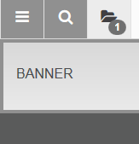
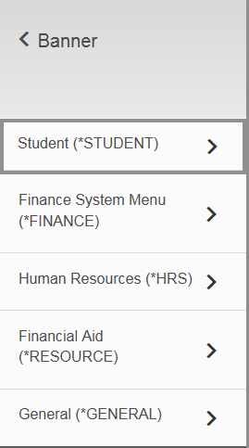
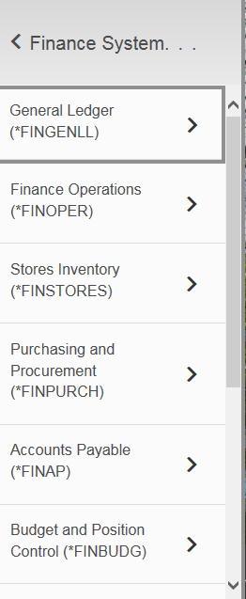
Navigating Banner Pages
You can also browse to the page by navigating through the menu folders on the General Menu (tiled bars); options will appear under the “Banner” name after selecting this option. Continue through the menu options.

Slide 11
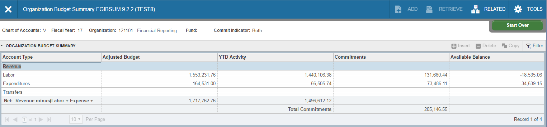
Navigating Banner pages
You can also use the Related menu on the Toolbar to access a more detailed view of a related page. Select Related from the toolbar to see which detail pages can be opened from an existing page.
Select “Related” icon to see a more detailed view of your page results. After selecting “Related”, a list of other available pages will appear in a drop down menu.

Slide 12
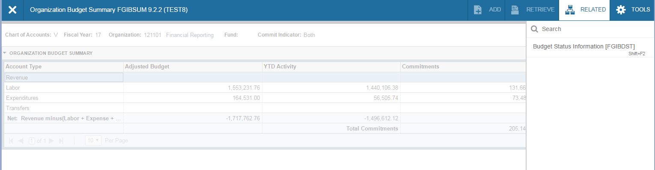
Navigating Banner Pages
You can also use the Related menu on the Toolbar to access a more detailed view of a related page. Select Related from the toolbar to see which detail pages can be opened from an existing page.
Select “Related” icon to see a more detailed view of your page results. After selecting “Related”, a list of other available pages will appear in a drop down menu.

Slide 13
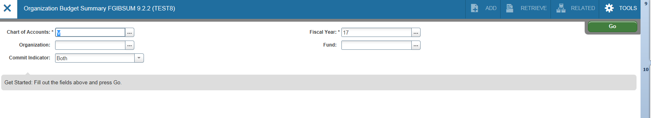
FGIBSUM-Organization Budget Summary Page
(Acronym=Finance, General Ledger, Inquiry, Budget Summary)
FGIBSUM displays summarized budget information for a selected organization. Adjusted Budget (Current Budget), year-to-date activity (transactions), commitments (encumbrances) and available balance are summarized on this page by major category type. In the key block area (top of the page) enter the org (organization or index number) and press the tab key on your keyboard. You can also change the Fiscal Year by using the drop down box or manually changing it. Ignore the Commit Indicator. VCU does not use this field. Click on the “GO” icon.
You can change the Fiscal Year here.
Ignore
Enter your Org (Index Code) here, then press the Tab key.
Select “Go” icon to see page results.

Slide 14
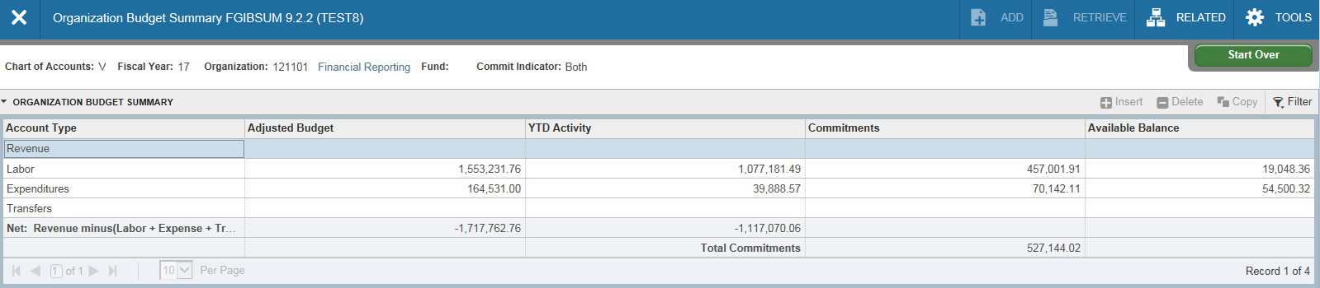
FGIBSUM (continued)-The activity on the page is summarized by Type: Revenue Labor, Expenditures and Transfers. You’ll notice that this particular org has budget and activity in labor(personnel expenses) and expenditures, but no revenues. Since the Banner default is to assume revenues and subtract expenditures, you may find the negative numbers in the Net Total fields to be misleading. This is something you’ll have to keep in mind for orgs with expenditure budget only. The Available Balances shown are correct, but they include any Commitments (encumbrances).
The Net Totals will appear as negative if the Org does not earn revenues.
The Available Balance appears correctly, but includes Commitments.

Slide 15
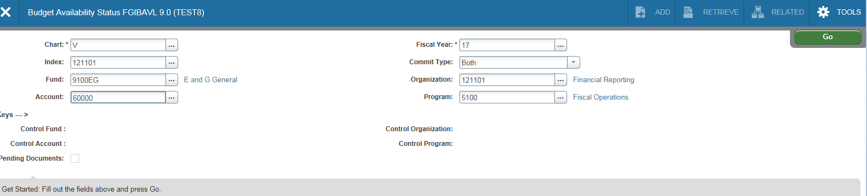

FGIBAVL-Budget Availability Status
(Acronym=Finance, General Ledger, Inquiry, Budget Availability)
FGIBAVL provides an overview of your department’s budget by budget pool (a summarized expense category). The page summarizes the current budget and expenditures in major categories with available balances given for each pool. Tab to the Index field and enter your Index code. Press the tab key. This page requires you enter an Account code as well. For example, to view all pools and expenditures, enter 50000 in the Account field. To view all non-salary related expenditure budget pools, enter 60000 in the Account field. Leave the Commit Type indicator set to Both. VCU does not use this particular feature. Click the “Go” icon when ready to view the results.
3. Click on the “Go” icon.
2. Enter the budget pool account in the account field. All subsequent budget pools will display. Here we’ve chosen non-labor expenses.
4. If you do not enter an account code before clicking on the “Go” icon, you will receive this notice.
1. Enter the Index. Press tab key.

Slide 16
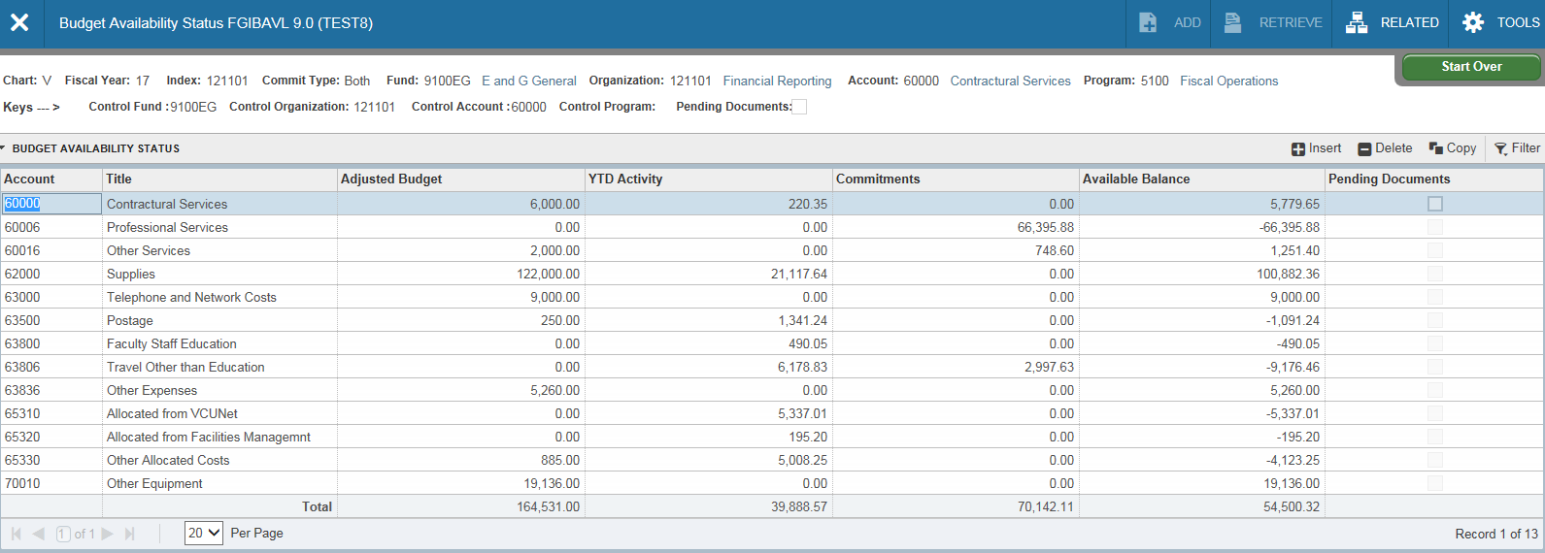
FGIBAVL(continued)-a budget pool is a 5 digit summary account used for budgeting purposes only. For instance, telephone and network costs are budgeted in account pool 63000. Transactions for telephone and network costs will post to the more specific 6 digit accounts that fall under this budget pool.

Slide 17
FGIBAVL(continued)-Current budget*, year-to-date expenditures, commitments and available balance are shown for each major budget category (budget pool), excluding salaries. You’ll notice on this page that the totals are positive numbers as this page does not include revenues. This particular page will not return results for accounts beginning with 4 (revenue accounts).
*Permanent Budget is not shown on Banner pages, only Adjusted Budget (which is your Current Budget). To see Permanent Budget you can either query all permanent budget transactions (see pages 27-28 of this module) or use the permanent budget reports available in Banner Self-Service (eServices).

Slide 18
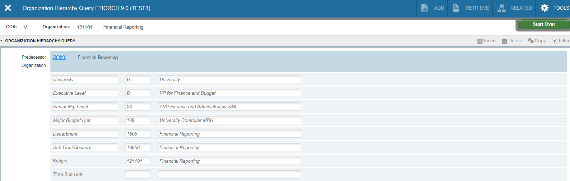
FGIBDSR-Executive Summary
(acronym=Finance, General Ledger, Inquiry, Budget Summary)
This page provides more specific information than the previous two, as the accounts are not summarized. The main advantage of this page is the ability to view financial data that is rolled up to higher organizational levels. In Banner, individual indexes roll up to sub-departments, sub-departments roll up to departments, departments roll up to major budget units and MBUs roll up to Senior Management Levels, etc. Too see this relationship, go to Banner page FTIORGH (example below) and enter an index code in the organization box. Click the “Go” icon. You’ll notice the numeric value is smaller as the organizational hierarchy is increased. This is useful for department managers who want to view summarized financial data for an entire department or school.

Slide 19
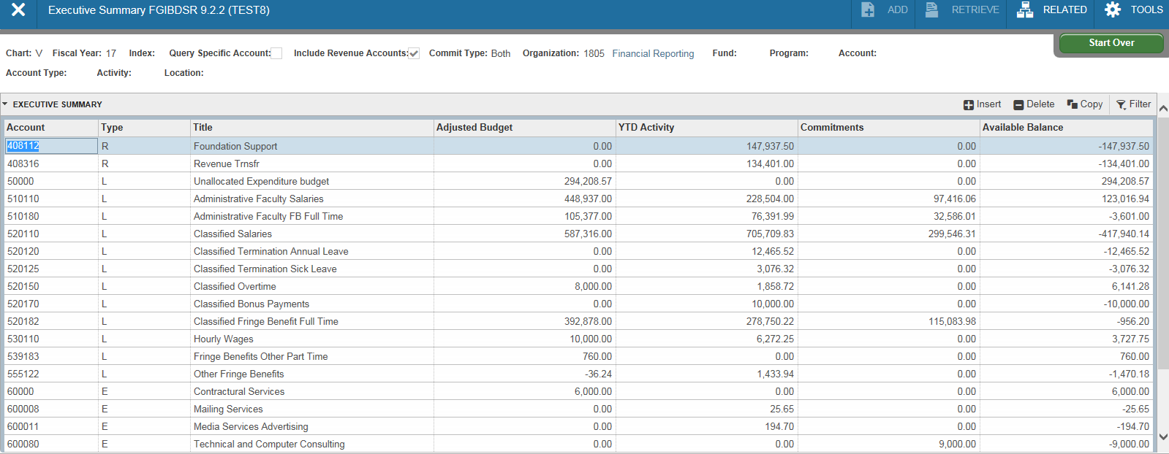
FGIBDSR (continued)- From the main Banner page, type FGIBDSR. Let’s enter a value for a department level rather than a single index in the Organization field. This is a four digit code rather than six. Press the tab key on your keyboard. Click on the “Go” icon. The financial data shown is for all indexes that roll up to this department. If you want to restrict the view to department indexes with a particular fund source, enter a fund in the Fund field (i.e., 9100EG for E&G funds). You’ll notice the Net Totals are returned as negative numbers. By default, Banner assumes offsetting revenues. To view expenditures only, click on the Start Over icon and uncheck Include Revenue Accounts. Then click on the “Go” icon.
Start Over icon to enter new criteria

Slide 20
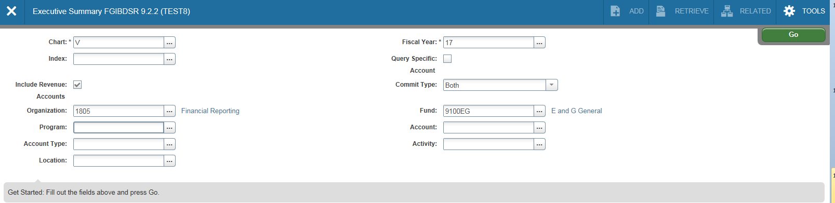
FGIBDSR (continued)
Department Code
Uncheck Include Revenue Accounts
“Go” icon

Slide 21
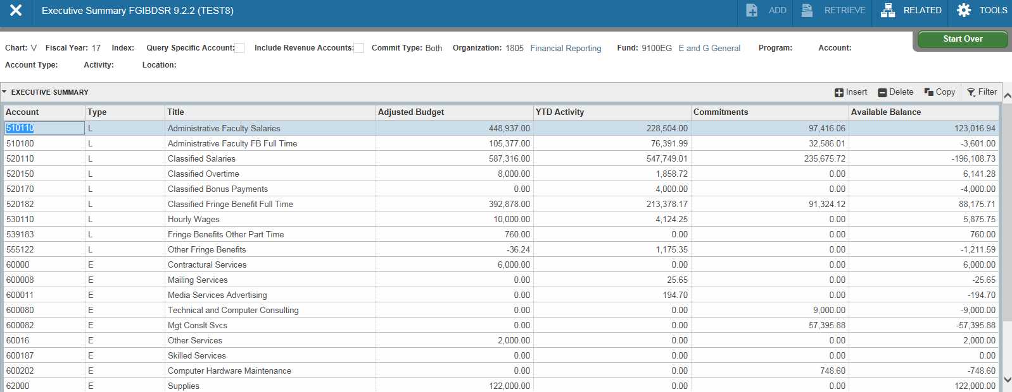
FGIBDSR (continued)
Include Revenue Accounts unchecked

Slide 22
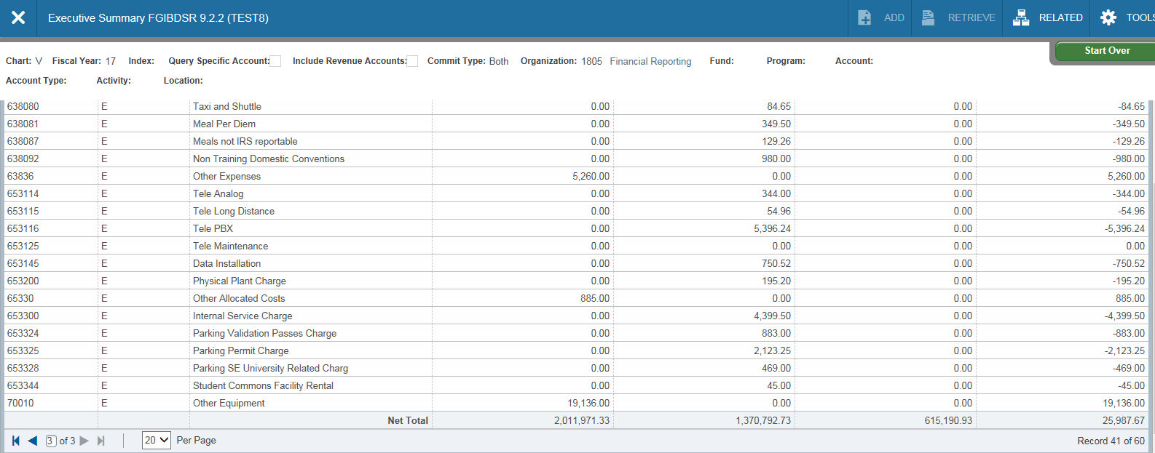
FGIBDSR (continued)-The financial data shown is expenditure activity for the entire department. You’ll notice the Net Totals are now positive numbers.
Fund is empty, so all fund sources.

Slide 23
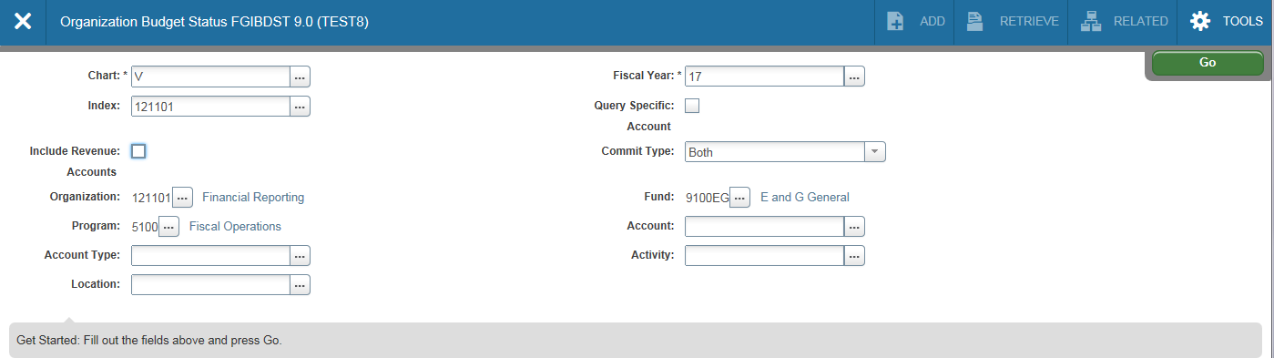
FGIBDST-Organization Budget Status
(acronym=Finance, General Ledger, Inquiry, Budget Status)
This page is probably one of the most useful pages in Banner. It provides up to date information on adjusted budgets, year-to-date expenditures, open commitments and available balances. In the key block area, select your fiscal year (if other than current) and type in your Index code. Press the tab key on your keyboard. If you want to view all financial data for this index, leave the Account field blank. If this particular index does not earn revenues, remember to uncheck Include Revenue Accounts or your Net Totals will be returned as negative values. Leave the Commit Type Indicator set to Both. VCU does not use this feature. Click on the “Go” icon to see the results.
Enter Index code
Uncheck Include Revenue Accounts if Index does not earn revenues.
Leave Commit Type as Both. VCU does not use this feature.

Slide 24
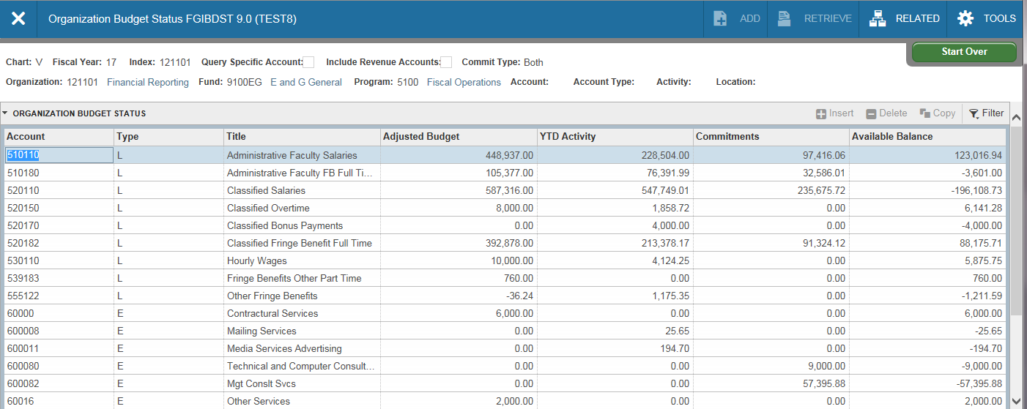
FGIBDST (continued)-You’ll need to use the scroll bar to view all the accounts returned on this page. The Adjusted Budget shown is your Current Budget. YTD Activity is year-to-date expenditures through today. Commitments are your encumbrances (outstanding purchase orders, etc.). The Available Balance field includes your commitments (deducts from your balance).
Use the Scroll Bar to move through the page.

Slide 25
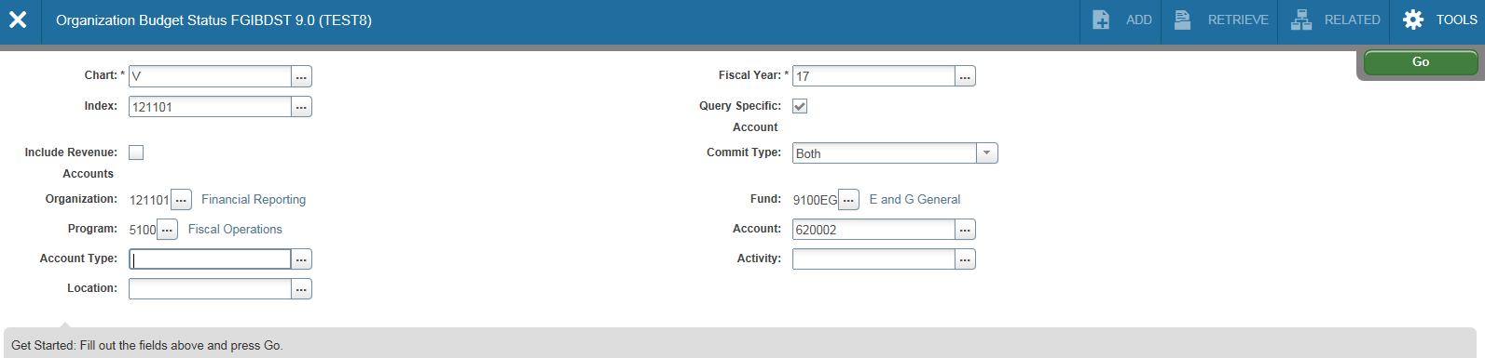
FGIBDST(continued)-To view detailed transactions that make up your year-to-date activity, you can enter the Account you wish to view in the account field; be sure the “Query Specific Account” box is selected; then select the “GO” icon; highlight the specific account from the account list. This will give you a list of all transactions (budget, expenses and commitments) that posted to that account code.
Check the Query Specific Account box
Enter account.

Slide 26
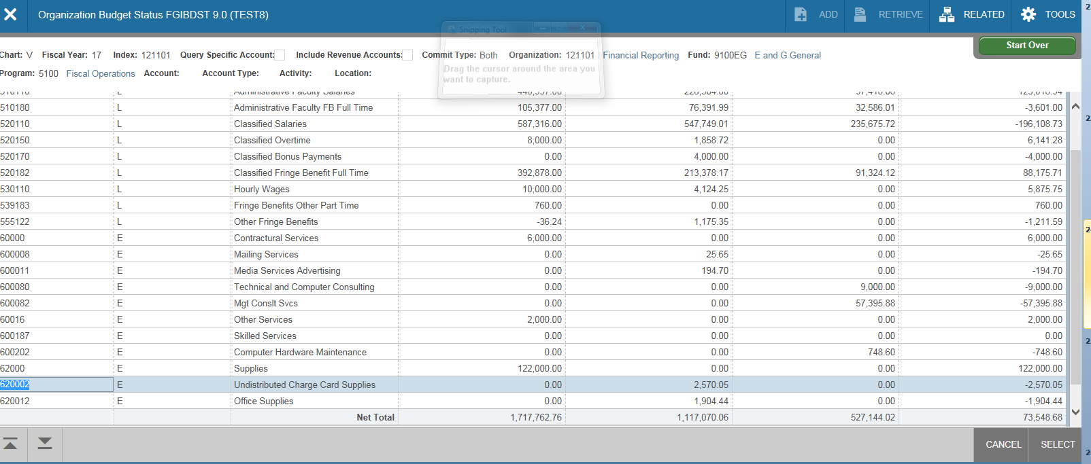
FGIBDST(continued) click once in the field for the transactions you want to view (for the specific account you wish to investigate). In this case, year to date activity for Undistributed Charge Card Supplies. Then, press the F3 key on your keyboard. This brings up page FGITRND.
Click into the box you wish to see a more detail listing of activity, hit F3

Slide 27
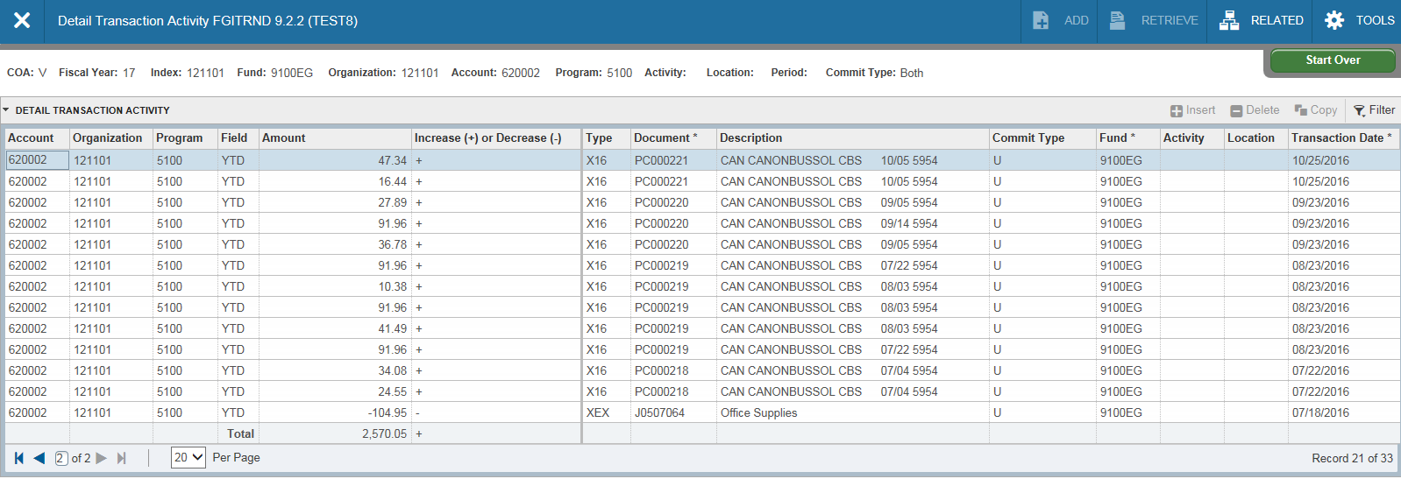
page FGITRND (Transaction Detail) will open showing all transactions that have posted to the account. Transactions with YTD in the Field column are items that have been paid. ENC in the field column are commitments (purchase orders). Transactions with fields beginning with AB or OB are budget related entries.
The Type column (the Banner rule class) identifies the specific type of transaction. Transactions beginning with X are journal voucher entries. The X type entries shown here are corporate card purchases which are uploaded as a journal voucher each month. Types beginning with H are wage related entries. Payments to vendors are types beginning with I. Creation of a purchase order is identified with type beginning with P.

Slide 28
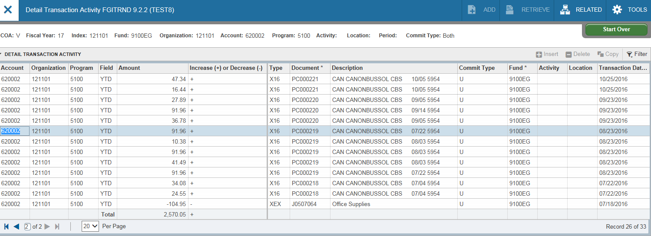
FGITRND (continued)-To view more detailed information about a transaction, click once on the line of the transaction you wish to query. Select F3. Ensure the document and document type are correct (remember “X” represents a journal voucher type).
Click once to highlight the line, select F3.

Slide 29
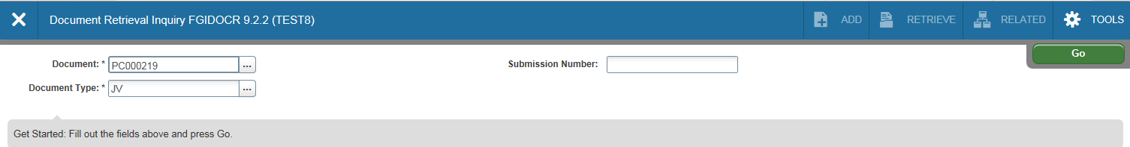
FGIDOCR (continued) - Ensure the document and document type are correct (remember “JV” represents a journal voucher document). Select “Go” icon

Slide 30
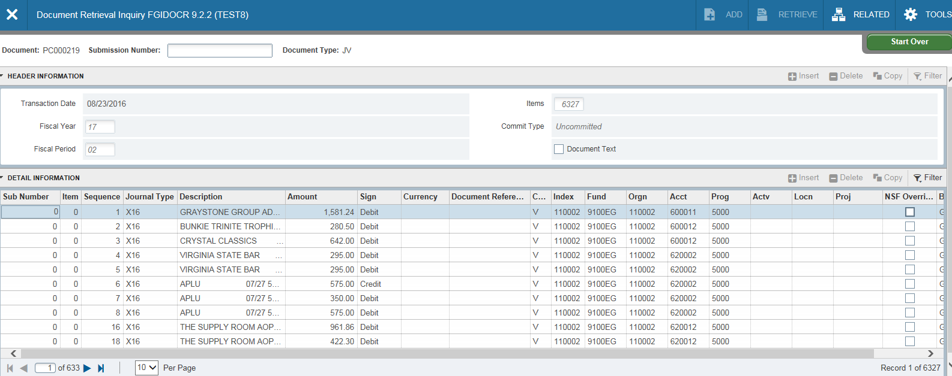
FGIDOCR (continued) – Details of the transaction will display. To find the specific line item, you will need to scroll through the items or add a “filter”.
Select Filter, where you will have multiple choices to filter on a specific piece of information.

Slide 31
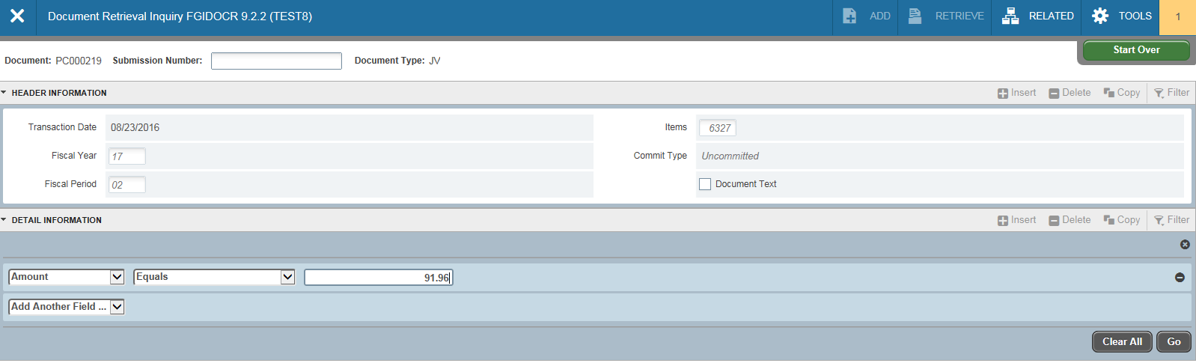
FGIDOCR (continued) – We have elected to use the amount. Enter the applicable inpageation, and select “Go” icon
Select Filter, where you will have multiple choices to filter on a specific piece of information. Select “Go”.

Slide 32
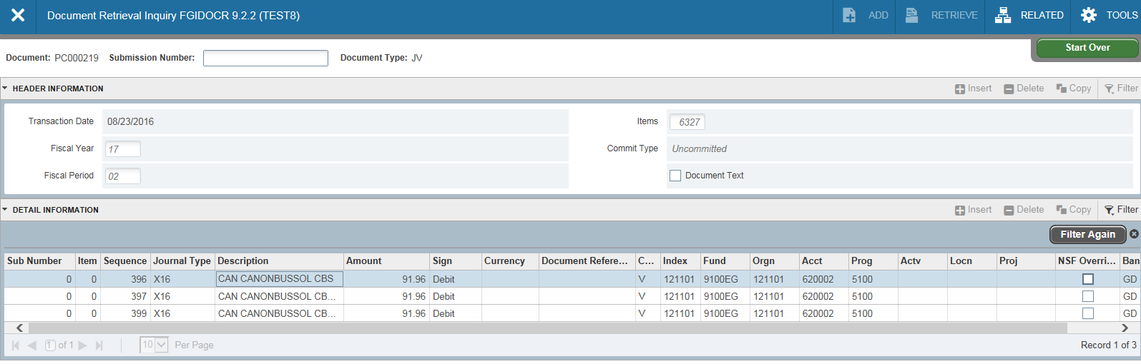
FGIDOCR (continued)-Details of the transaction will display. To obtain more information, select the line, and hit F3. To return to FGITRND (Transaction Detail) or the FGIBDST (Budget Status) page, simply click the black X on the Banner menu bar until you return to your starting point.
Exit until you return back to your starting point.
Select the line item, and hit F3 for more information

Slide 33
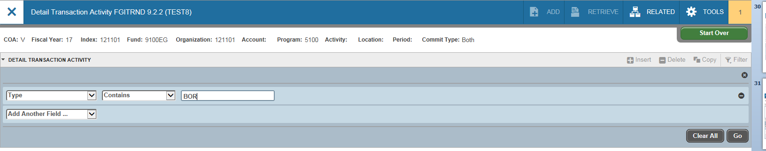
FGITRND-You can also use this page for queries. After entering the Index information and selecting “GO”. Click on the Next Block icon. A block will appear asking to add another field will appear under “Detail Transaction Activity”. Enter your query parameters. In this example, we’re looking for all original permanent budget entries for this organization. The original permanent budget is loaded at the beginning of the fiscal year. In the Field column, enter OBD. Next click on the “Go” icon.
Select “Type”, enter BOR
Select “Go”

Slide 34
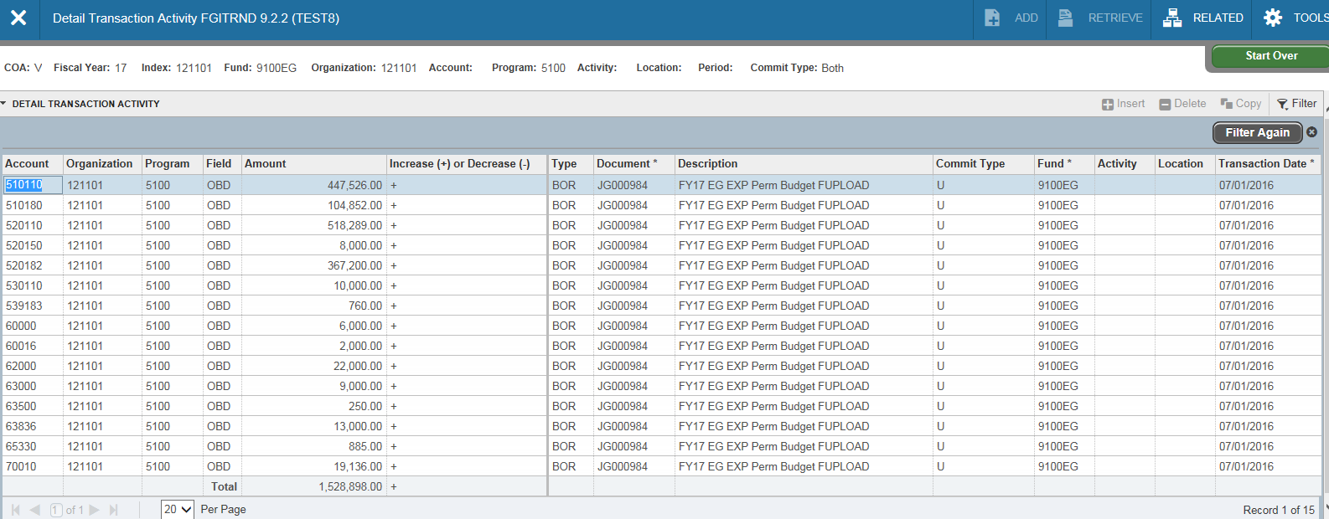
FGITRND (continued)-All original permanent budget entries that were posted to this organization will be returned on the page. You can use more than one parameter on this page to confine your search to more specific information. You’ll find other examples in the pages Handbook located in the Course Documents section of this course.

Slide 35
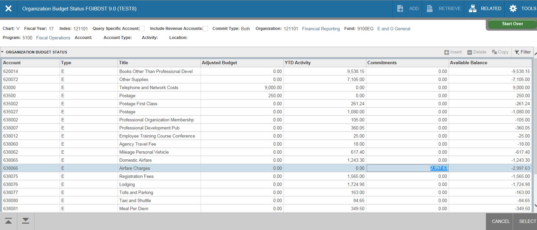
From page FGIBDST you can also view a list of outstanding encumbrances (purchase commitments) for this org. Click on the specific line item, hit F3 on your keyboard. Select F3 again to drill down further on the specific line item you wish to investigate.

Slide 36
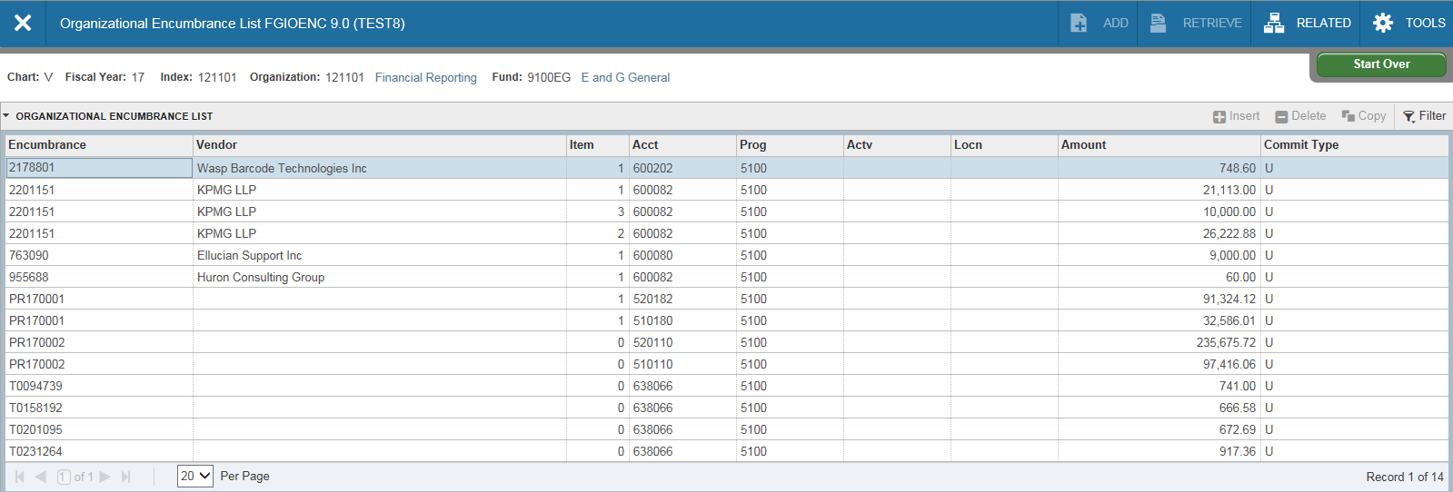
FGIOENC(Org Encumbrance). From the Related drop down menu you can select Organization Encumbrances or from the main Banner menu, type FGIOENC and enter the index you wish to investigate. A list of balances associated with the org will display. The number under Encumbrance is the EP number or the purchase order number. The Amount is the remaining balance of the purchase order after payments.
Encumbrance and amount

Slide 37
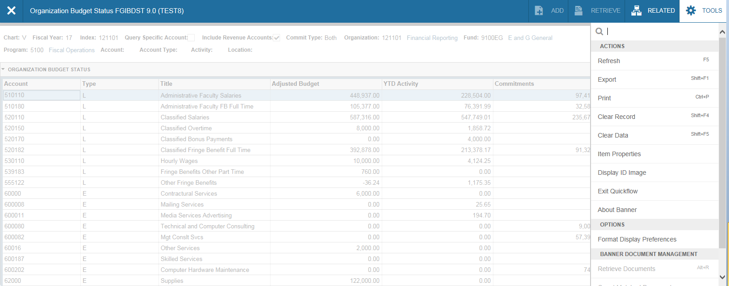
The Budget Status page (FGIBDST), as well as many other pages, can be downloaded into an Excel spreadsheet. To do this, select “Tools” and Export on the right side of screen. On other pages if this option is grayed out, you’ll know the page cannot be downloaded.

Slide 38
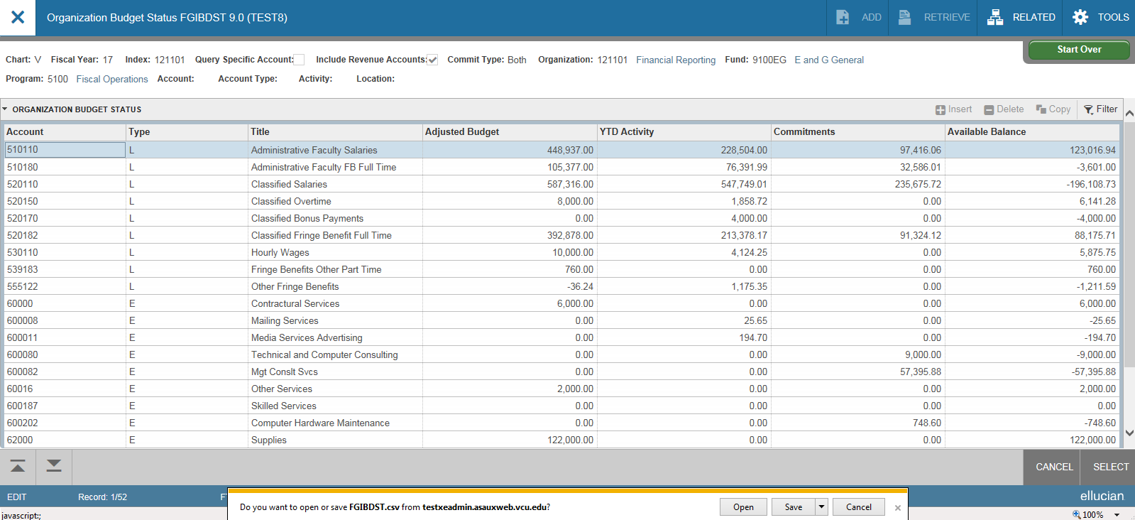
The Budget Status page (FGIBDST), as well as many other pages, can be downloaded into an Excel spreadsheet. To do this, select “Tools” and Export on the left side of screen. You will see a message appear on the bottom; select “open” or “save”. On other pages if this option is grayed out, you’ll know the page cannot be downloaded.

Slide 39
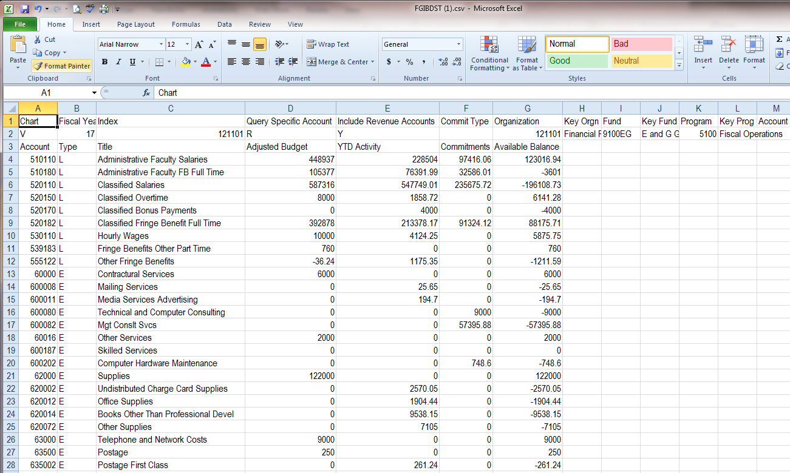
The file will download with the column headings and you’ll need to adjust the column widths as well as the number formatting.

Slide 40

There are many useful Banner pages that deal with purchase orders and vendors. Let’s look at a few of them. FOIDOCH (Document History) gives you a comprehensive look at purchase orders and other documents. With a PO number, you can view information about the PO, invoices received and the corresponding receiving entries. You can access FOIDOCH from the Banner Welcome page by simply typing in the page name.
Enter the page name. No difference than when typing in other pages you are planning to use

Slide 41
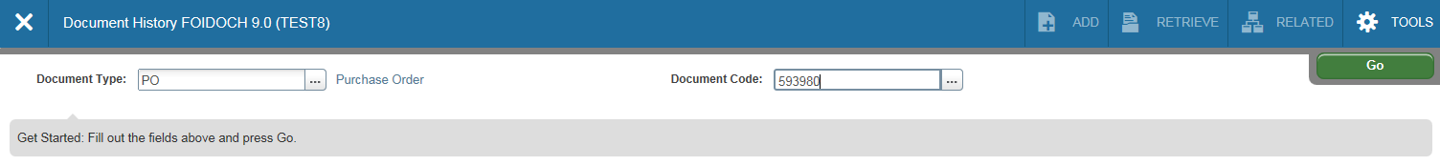
Type PO in the Document Type box. Tab to Document Code and type in your PO number (without EP). Click on the Go icon.

Slide 42
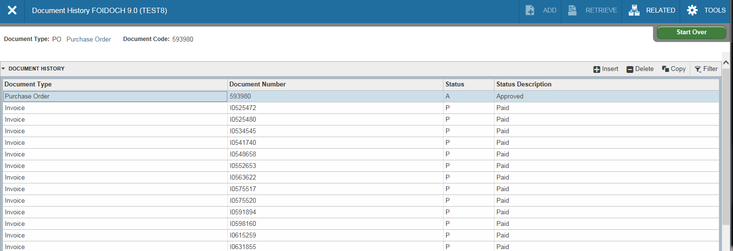
From here you can navigate to specific information about the purchase order, invoices for that purchase order, Banner receivers completed for the invoices and the checks disbursed.

Slide 43
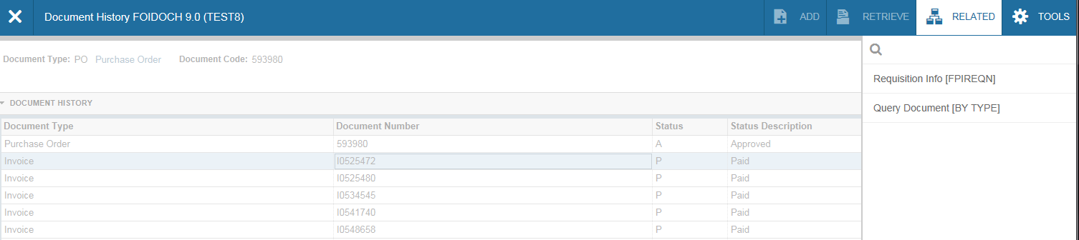
To view a specific item, click in the field where the item is listed. In this example, we’ve selected an invoice. Hit F3 or under “Related”, select Query Document.
Click on the invoice number. Select Related/Query Document (by type)

Slide 44
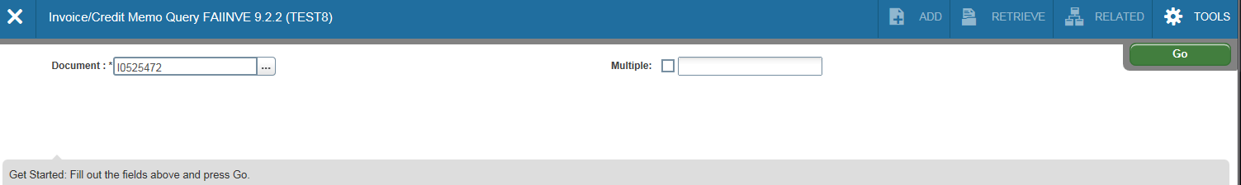
page FAIINVE (Invoice query) will open. After selecting Query Document, the invoice number previously selected will appear in the document field. Select the Go icon. Information on the invoice will then appear.
Previously selected invoice number. Select the Go icon

Slide 45
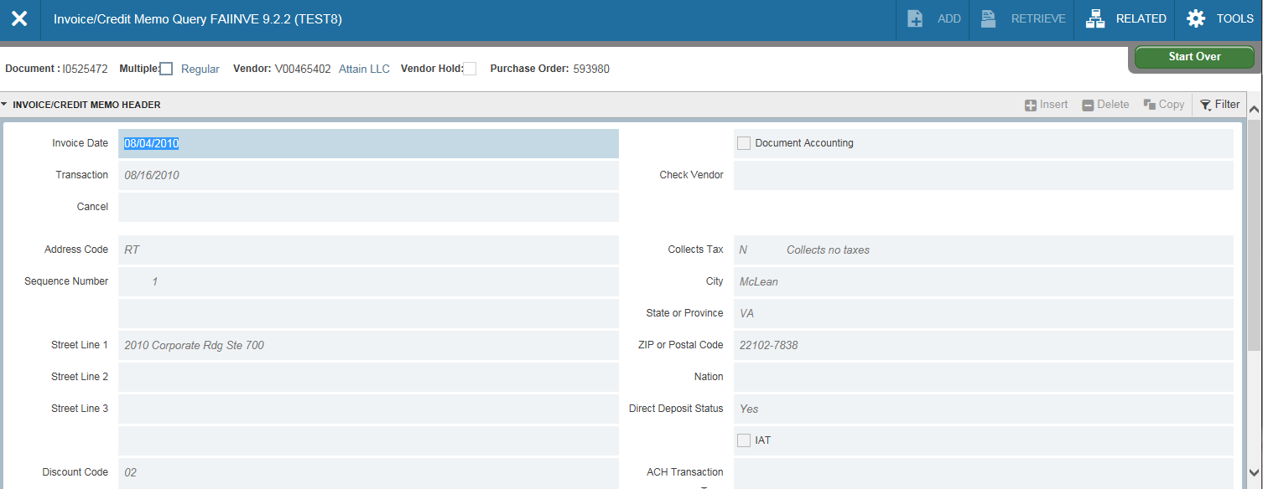
page FAIINVE can also be accessed from the Welcome page. Enter the invoice number in the document field and Select the Go icon.
Information on previously selected invoice number.

Slide 46
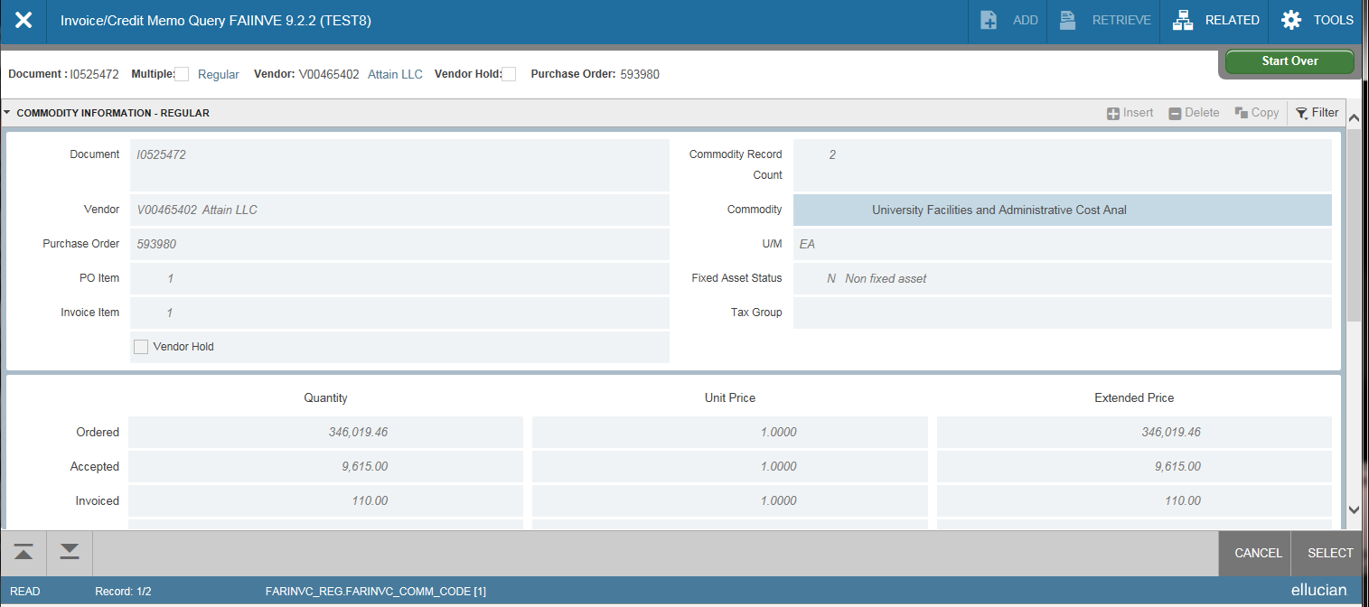
Information for the invoice number previously selected will appear. Use the up/down tabs located in the bottom left to view different sections of the document.
Use up/down tabs to move through the document.

Slide 47
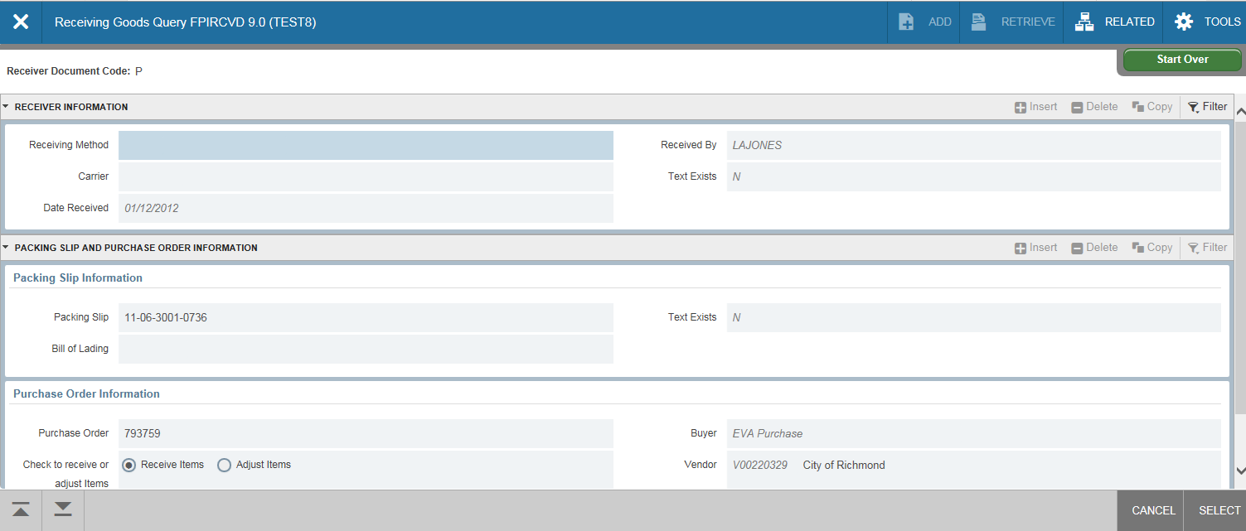
From the Welcome page, type page FPIRCVD (Receiving Goods Query) and enter the Receiver’s eID.

Slide 48
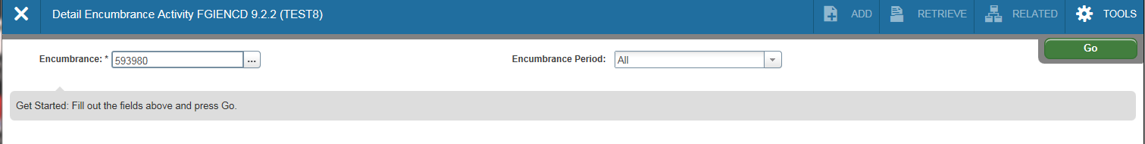
Another useful page for purchase orders is FGIENCD (Encumbrance Detail). From the Welcome page type in page FGIENCD, enter the purchase order number (do not include EP). Select the Go icon.

Slide 49
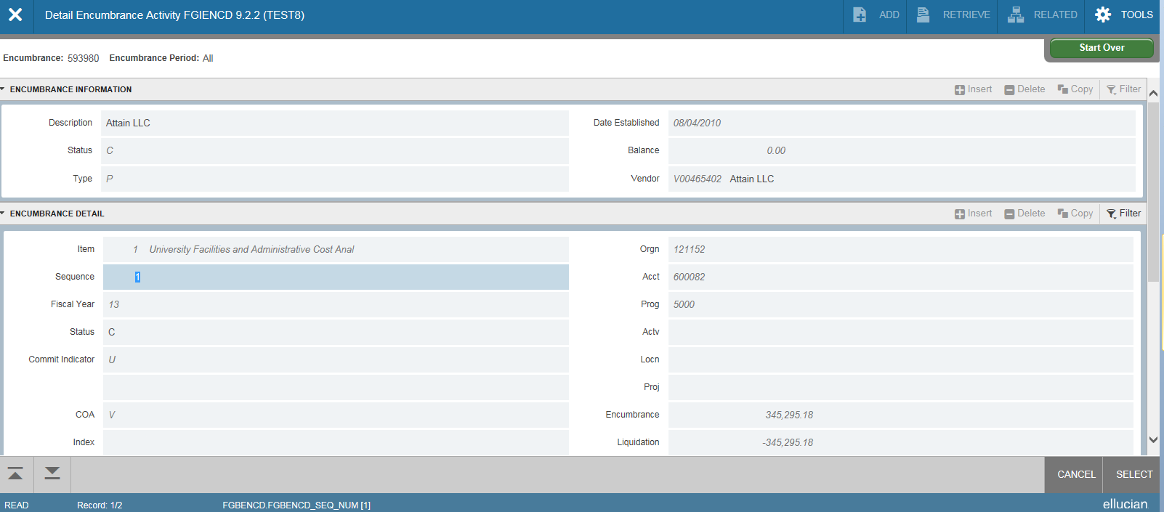
FGIENCD (continued)-This page shows a detailed accounting of the purchase order in chronological order. In the Type field: PORD would be the original purchase order, CORD are purchase order changes, INEI are the invoices processed against the order and E090 indicates the PO rolled over from the previous fiscal year.
Use the up/down tabs, and scroll bar to move through the document.

Slide 50
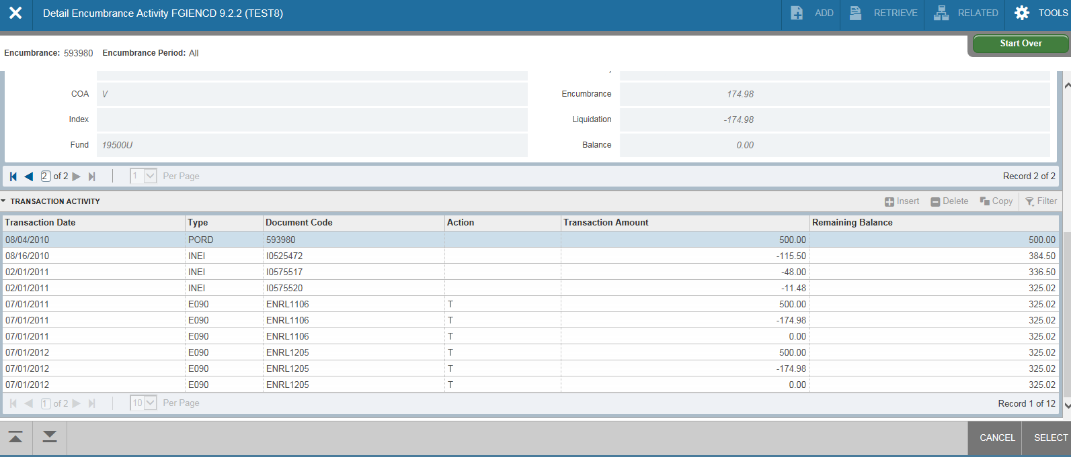
FGIENCD (continued)
Document types.

Slide 51
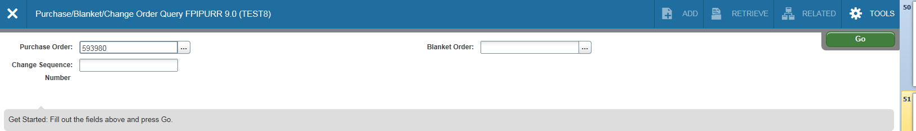
Type FPIPURR (Purchase/Blanket/Change Order Inquiry) from the Welcome page; this page is useful when you’re looking for purchase order origination information. Type in the PO number (no EP) and select the Go icon.

Slide 52
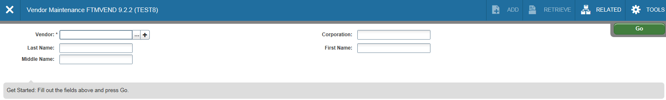

It is often necessary to see if a vendor has been entered into the Banner system. The easiest way to do this is to use FTMVEND (Vendor Maintenance) and Banner’s built in search tools. From the Welcome page, Go to page FTMVEND and click on the drop down arrow next to the Vendor field.

Slide 53
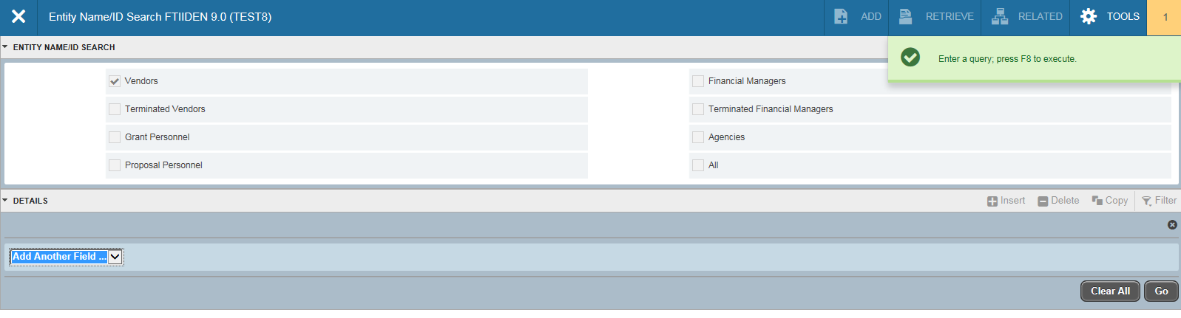
FTMVEND (continued)-Click in the shaded line and select the search criteria. Enter F8 to execute query, or select the Go icon .

Slide 54
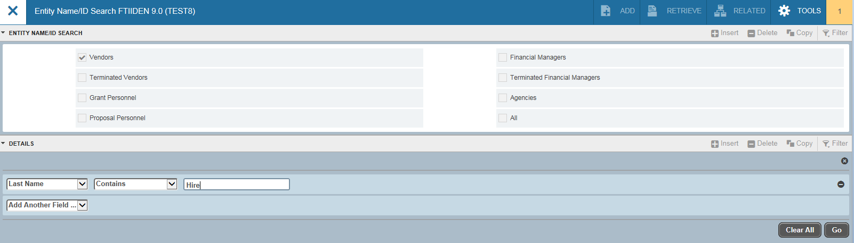
FTMVEND (continued)-Click in the shaded line in the Last Name field and type in part of the vendor’s name. Enter F8 to execute query, or select the Go icon .
Type in part of the name. Click on Go icon.

Slide 55
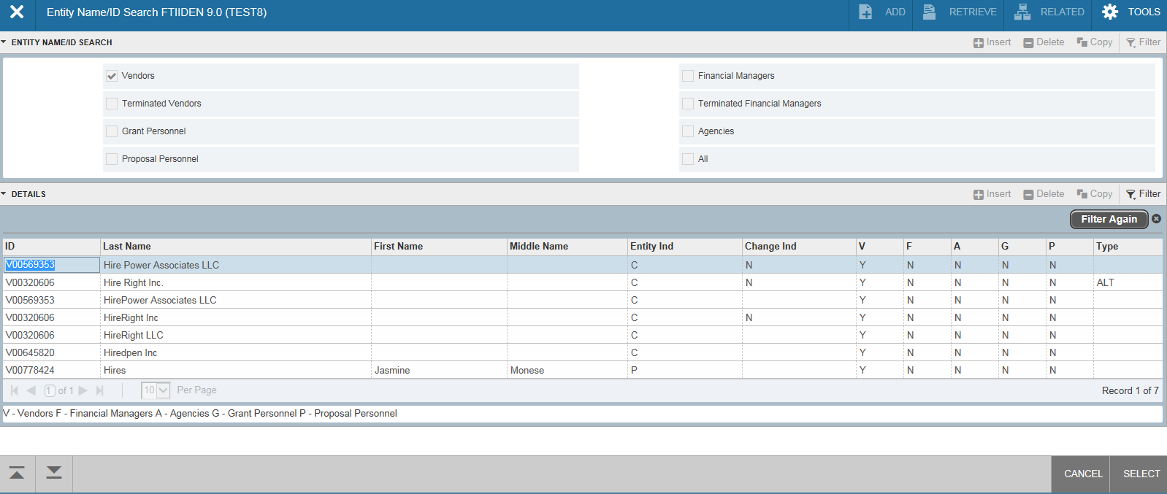
FTMVEND (continued)- The page will return the closest matches to your query. To view more specific information about the vendor, double click on the vendor name.
Double click on the desired line.

Slide 56
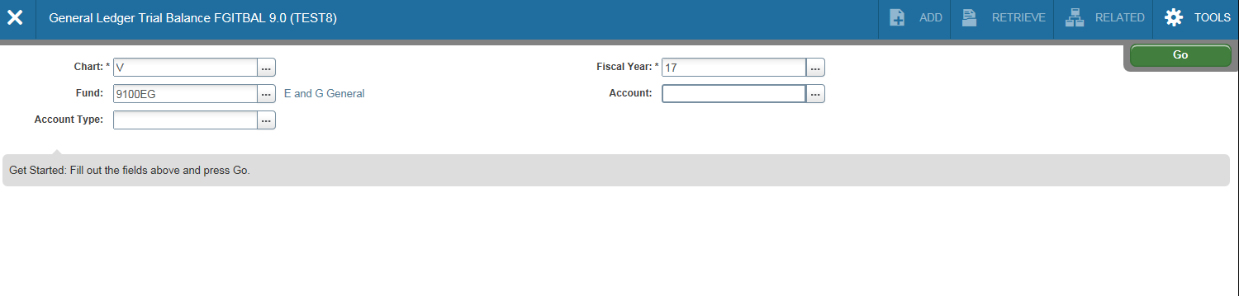
With Grant funds it is often necessary to look at fund (general ledger) information. Remember, Indexes roll up to Funds which can be a one-to-one or many-to-one relationship. Banner pages for Funds provide general ledger information such as assets (cash) and liabilities (payables) associated with their subordinate indexes. Let’s look at Banner page FGITBAL(Trial Balance). From the Welcome page type in FGITBAL; type in a Fund code. Press the tab key. You can also select which types of accounts you want to view by using the drop down menu next to Account Type. To view all accounts, leave this field blank. Click on the Go icon.
Select Go after entering pertinent information
Enter Fund, select Account or leave blank for all accounts.

Slide 57
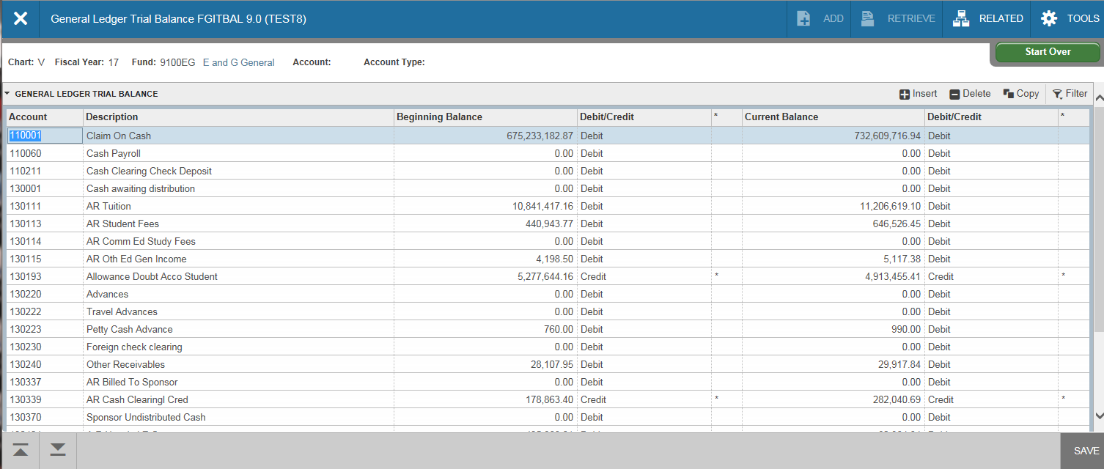
FGITBAL (continued). On this page you’ll notice that current account balances are shown as debits and credits. Cash should be a debit balance. A credit cash balance indicates a deficit situation. Any accounts that show a credit or debit balance out of the ordinary will have an asterisk next to the field.

Slide 58
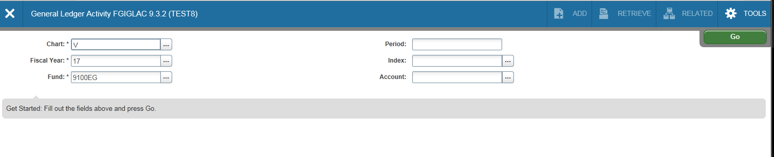
Another general ledger page, FGIGLAC (General Ledger Activity), shows detailed transaction activity for each account. You can access FGIGLAC from the main Welcome page. Select the fund, period, index, and account.
Select Fund, Period, Index, and Account.

Slide 59
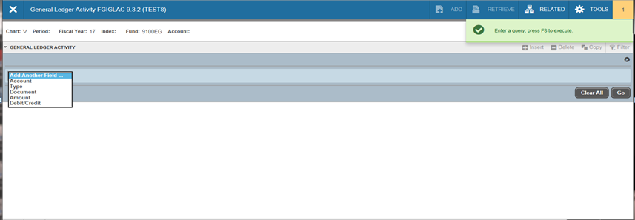
FGIGLAC (continued)-The FGIGLAC page will open and prompt you for field search criteria (account, type, amount, etc). Enter desired search criteria information, hit F8 on your keyboard or select the Go icon.
Enter search criteria (account, type, amount, etc). Hit F8 on keyboard, or select Go icon.

Slide 60

FGIGLAC (continued)-The FGIGLAC page will open showing all transactions that posted to the account. To see the detail of any of the transactions, you would “filter again” using other search criteria such as Document number.
Select Filter Again, and enter additional/new search criteria such as document number. Hit F8 on keyboard, or select Go icon.

Slide 61

FRIGITD (Grant Inception to Date) is a useful page for grant administrators. This page displays activity for grants or capital outlay projects from the inception date (rather than just fiscal year). It’s a flexible page with many options. To use this page, you can enter either the Grant ID or the Index code (in which case the Grant ID will self populate). You can also specify a grant year or leave blank for all years. If the grant has more than one fund, you can also check Fund Summary to display a summary of each fund. You may also specify a date range to display or leave blank and the date range will self populate based on the origination of the grant. After filling in the pertinent information, click on the Go Icon.

Slide 62

FRIGITD (continued)-This page has options for the display of account activity. Level 1 Account Types is a summarized view.

Slide 63

FRIGITD (continued)-Level 2 Account Types is summarized by specific areas of activity.

Slide 64

FRIGITD (continued)-All levels of Account Summary displays all expenditure accounts. To view details of an expenditure account, click on the account then choose the Grant Transaction Detail page under related.

Slide 65

FRIGITD (continued)- Another way to view the detail of an expenditure account, enter the account on the criteria selection screen and select the Go icon.
Select an account, then select the Go icon.

Slide 66

FRIGTRD (Grant Transaction Detail) to reveal all transactions that posted to that account. From here the transactions can be queried further using the specific criteria shown.

Slide 67

Banner also has some built in reports. The most commonly used reports are FGRBDSC (Budget Status Current), FGRODTA (Org Detail Activity) and FGRORGH (Organization Hierarchy Report). To run FGRBDSC, from the Welcome page, type FGRBDSC , hit enter, then select the Go icon. In the Printer field, under Printer Control, it should read DATABASE. Enter the desired parameter values.
Enter the desired values

Slide 68
Click in the Values column and change the Fiscal Year (2 digits if needed). Make sure Chart of Accounts is equal to V (a capital V). Put in your org code or a range of org codes you wish to view. Limit the reports to certain accounts if you’d like, and put in an As of Date in the format of 6/30/2016.

Slide 69

Use the Next section icons in the lower left to toggle down in order to use the submission and save features.
Use up and down toggle to move to the save and submit section.

Slide 70
The field next to the Submit should be selected. Then click on the Save icon located in the bottom right corner. If this is a report you will run on a routine basis, you can also save the parameters and name the report.
Select Submit
Save icon
For routine reports, select save parameter, and name the report

Slide 71

The values you entered will disappear. To the right you’ll see two icons appear: the request is being processed, and the file name. The file ending in .lis is your report file.
Report File Name ending in .lis

Slide 72

Click on the Related icon to reveal the menu, and you will see the review output option. Select this option. Double click on the file name ending in .lis.
Select the Related icon, then review output

Slide 73

In the File Name, open the drop down menu, your report (.lis) will be listed. Select the report, and hit OK.
Use the drop down menu in File Name to locate your report
Select the desired report (.lis), and hit OK

Slide 74

Your report will display. To download the file and save to Excel, To do this, select “Tools” and Export on the right side of screen. You will see a message appear on the bottom; select “open” or “save”. On other pages if this option is grayed out, you’ll know the page cannot be downloaded.

